Slide 1


WHAT I CANNOT EXECUTE, I DO NOT UNDERSTAND : TRAINING AND EVALUATING LLMS ON PROGRAM EXECUTION TRACES
Inzish Khan 21L-62624
Javeria Pervaiz 21L-6280
Khadija Javed 21L-5686

Slide 2


OVERVIEW
“Why Shift Focus Toward Execution Traces in LLMs”
LLMs are increasingly used for code understanding and generation.
Code execution is essential to fully understand what a program does.
Direct prediction often gives plausible but incorrect results.
We need models that reason step-by-step, like humans do.

Slide 3


BACKGROUND
Nye et al. (2021)
→ Introduced scratchpads for LLMs to record intermediate computation steps.
→ Showed improved accuracy in predicting Python function outputs.
→ Limitation: Not scalable for long executions .
Ni et al. (2024) – NExT
→ Proposed compact trace representations to reduce trace size.
→ Simplified loops and focused on improving program repair.
Gu et al. (2024) – CruxEval Benchmark
→ Developed a benchmark specifically to test code reasoning via execution outputs.
→ Used as the primary evaluation suite in this work.

Slide 4
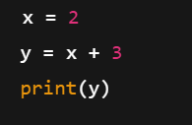

KEY CONCEPTS
Example
Execution Traces
A sequence of program states during code execution. States include variable values, control flow, etc.
1st Step : x = 2 → x becomes 2
2nd Step: y = x + 3 → y becomes 5
3rd Step: print(y) → output is 5

Slide 5
KEY CONCEPTS
INTRODUCTION OF DYNAMIC SCRATCHPAD
A scratchpad is an intermediate memory used by LLMs to store step-by-step computations before arriving at the final output.
Helps in tasks like code understanding and output prediction.
Execution Strategy
Direct (No Scratchpad)
Scratchpad (Regular Scratchpad)
Dynamic Scratchpad

Slide 6
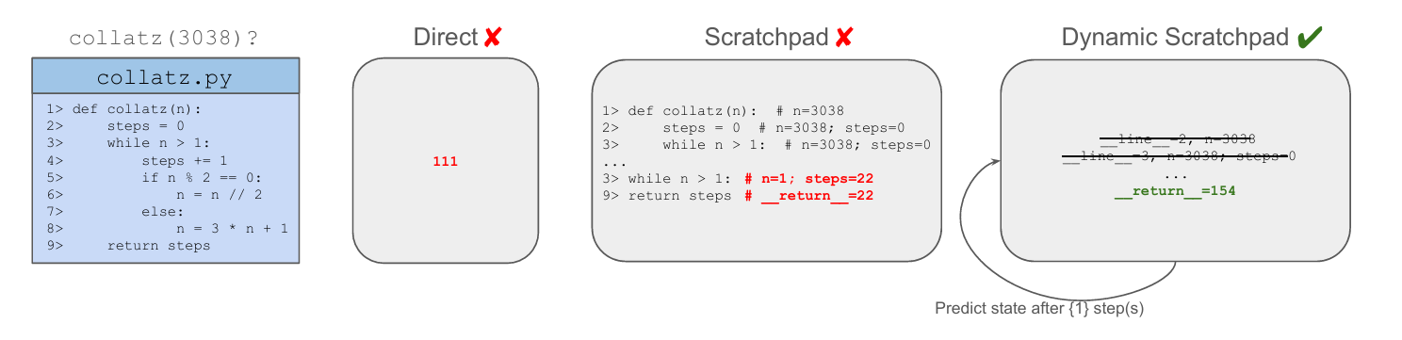
Why use Dynamic Scratchpad?
Updates a single, self-contained program state at each step.
Avoids accumulating unnecessary history.
Enables success on long executions (up to 14,000 steps!).
Allows dynamic step skipping, reducing trace size (e.g., from 14k → 1.5k).

Slide 7
Methodology

Slide 8
Challenges for Execution Tracing
Where and how to collect Exectuion traces
2. How to represent these traces to ingest them into the model

Slide 9
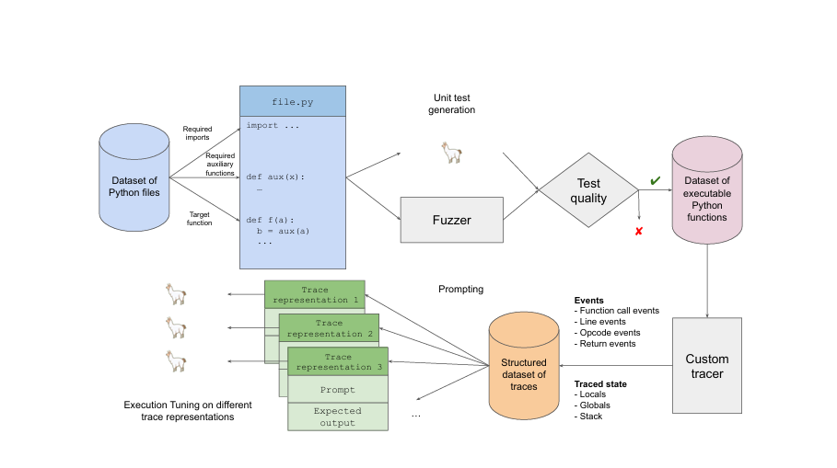
E.T Data Pipeline

Slide 10
TRACE COLLECTION PIPELINE
01
Generate a large, diverse dataset of executable Python traces.
Start with Python functions and common imports (e.g., pandas, matplotlib
02
Filters:
Discard inputs causing runtime errors.
Measure line coverage and test similarity to ensure quality.
03
Outcome:
300K functions with avg. 6 inputs each → over 1.5M executions.

Slide 11
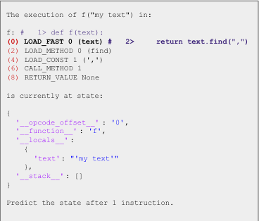
EXECUTION TRACING ENGINE: BUILT USING PYTHON’S SYS.SETTRACE
01
Captures Events
Function calls, returns, lines, and bytecode instructions.
02
Steps into:
User-defined auxiliary functions (same file).
Ignores external modules and C traces to avoid noise.
03
Also Captures
Global variables, stack state, and opcode-level changes.
04
Result
A structured dataset of fine-grained execution traces.

Slide 12
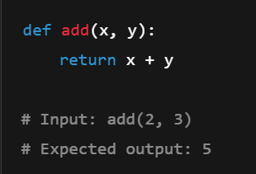
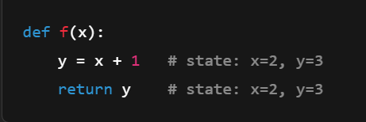
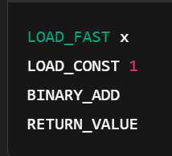
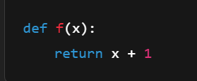
Trace Representation Granularities
Direct Predictions
Predict return value from inputs (no intermediate steps).
Line-level Tracing
Show state changes after each source line.
Instruction-level Tracing
Track bytecode execution + stack.
Inline source code comments for readability.

Slide 13
Scratchpad Reasoning Straegies
Scratchpad
Show full locals dict after each step.
Compact Scratchpad
Only variables that changed (diff-based).
Dynamic Scratchpad
Single evolving state.
Allows jumping ahead N steps.
Requires explicit encoding of iterators and stacks.

Slide 14
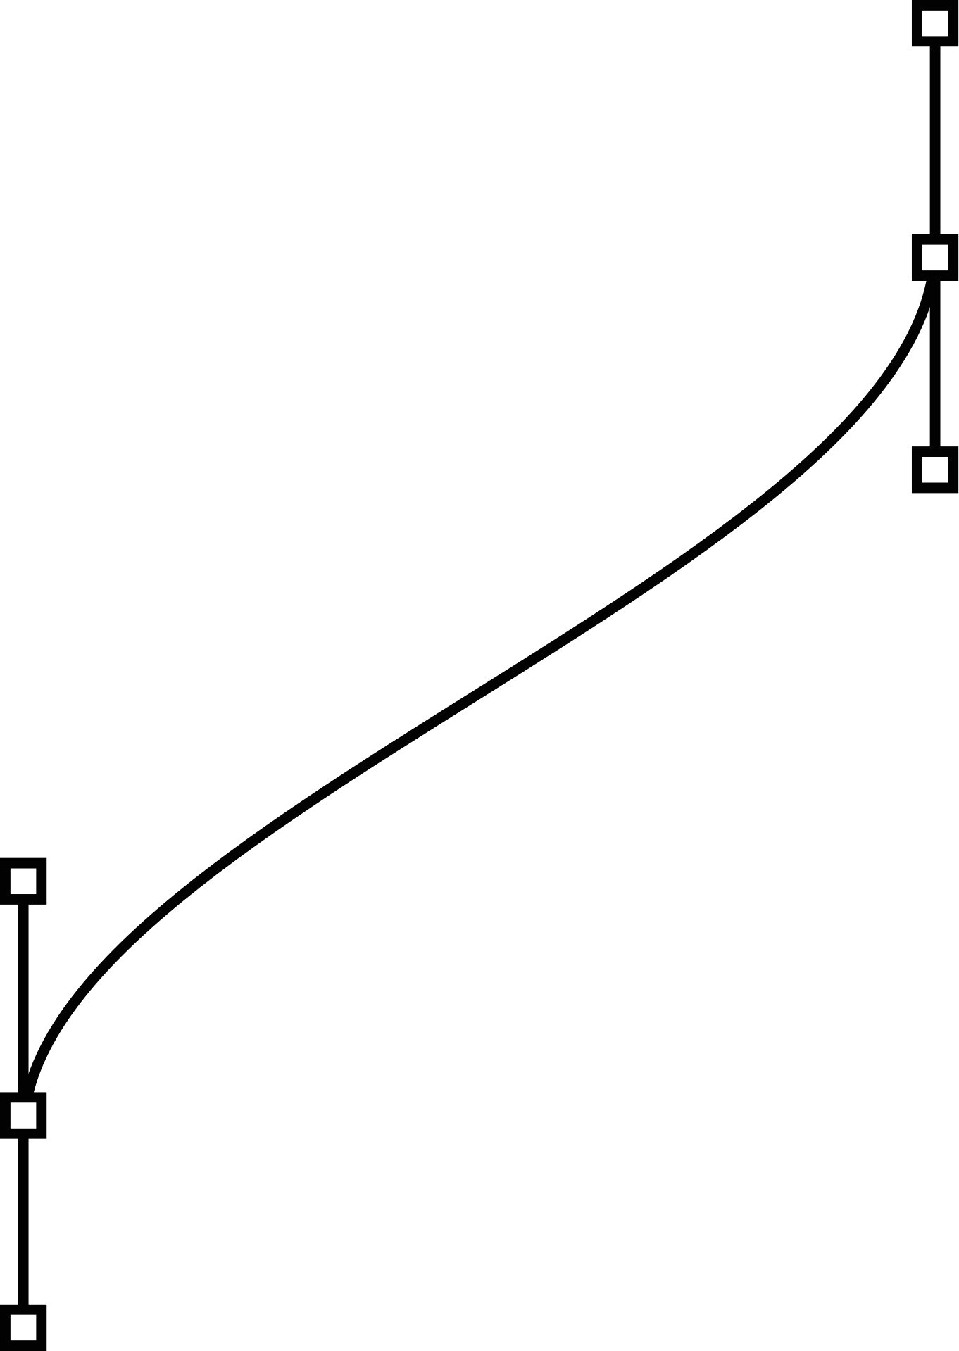

Results & Conclusion

Slide 15
RESULTS ON CRUXEVAL
OUTPUT PREDICTION
Baseline: ~50%
With Execution Tuning: ~80%
INPUT PREDICTION
Baseline: 11%
With Execution Tuning: 87%
Long Executions (14,000+ steps)
Dynamic Scratchpads enable:
More accurate intermediate computations
Better performance on complex, multi-step code

Slide 16
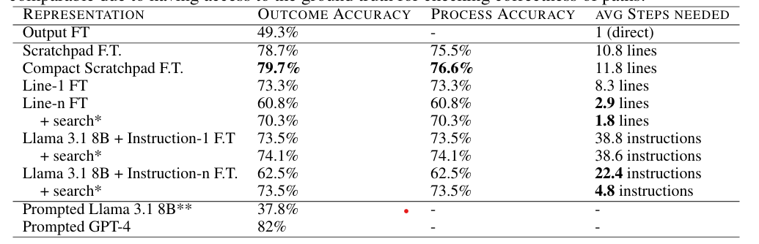
RESULTS ON CRUXEVAL

Slide 17
RESULTS ON MBPP
EVALUATION ON MBPP
Real-world coding prompts
E.T.-trained models show better generalization and accuracy
EXAMPLES
Improved performance in:
Variable tracking
Loop behavior
Conditional reasoning

Slide 18

CONCLUSION
The paper demonstrates that integrating execution traces through the Execution Tuning (E.T.) approach enhances language models' ability to understand and predict code behavior. By leveraging runtime information and dynamic scratchpads, the method improves both forward and backward reasoning tasks. These improvements lead to higher accuracy in benchmarks and suggest broader applicability in code-understanding tasks.

Slide 19

THANK YOU
Any Questions ?

